Slide 1
Management Information system
Management Information Systems (MIS).pptx

Slide 2
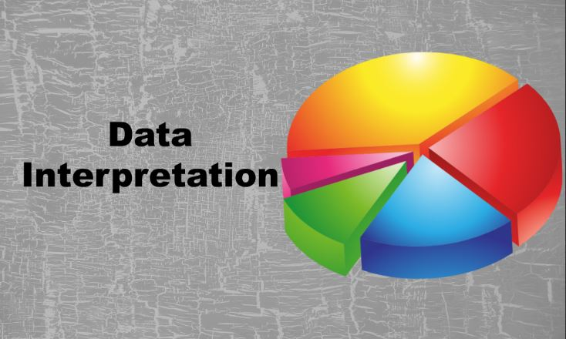
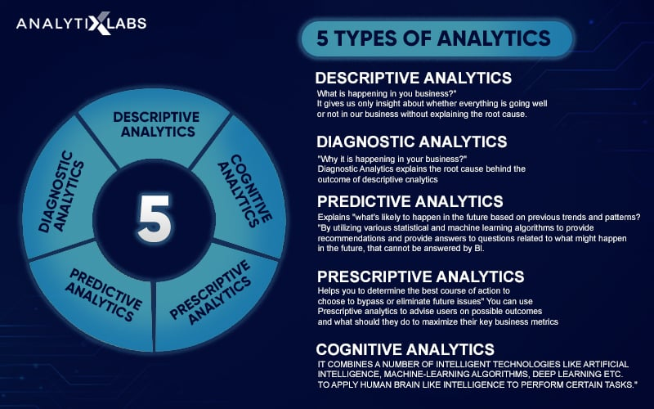
DBMS in MIS: Core Concepts & Applications
DBMS software facilitates interaction between end-users, applications, and databases for data capture and analysis.
Crucial for effective decision-making and operational efficiency in organizations.
Supports various MIS applications (TPS, MRS, DSS, EIS, CRM, SCM).

Slide 3
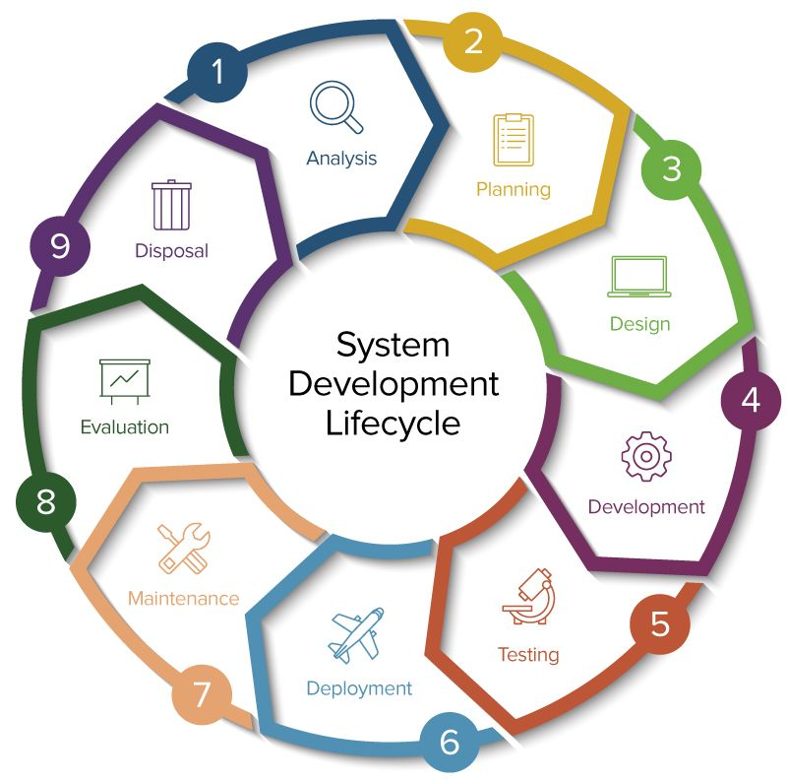
Introduction to Databases & DBMS
A database is an organized collection of structured information. A DBMS is the software that creates, maintains, and manipulates databases, providing user interfaces and ensuring data integrity, consistency, and security. Examples: MySQL, PostgreSQL, Oracle, SQL Server, MongoDB.

Slide 4
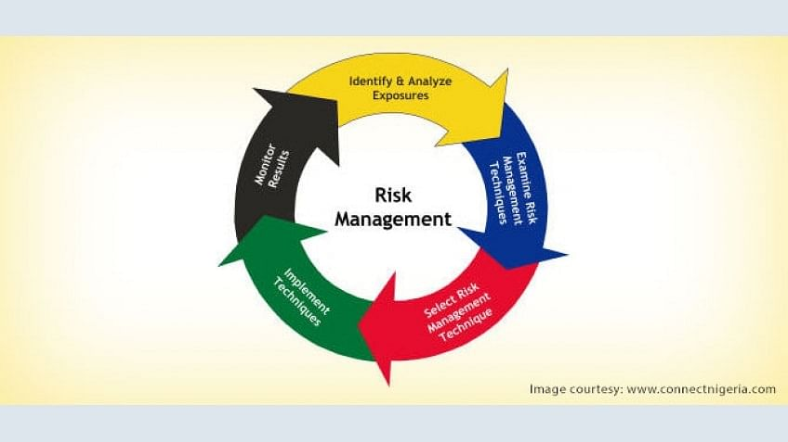
Database Types & Selection
Relational Databases (RDBMS): Data organized in tables with rows and columns, linked through relationships (e.g., MySQL, PostgreSQL). NoSQL Databases: More flexible and scalable, handling diverse data structures (e.g., MongoDB, Cassandra). Database type selection depends on application and data characteristics.

Slide 5
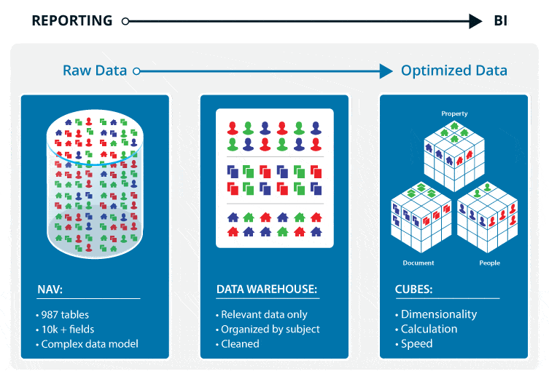
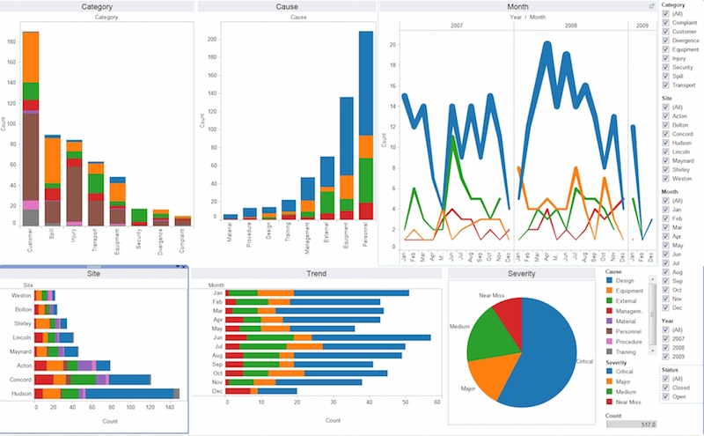
Key DBMS Components
Data Definition Language (DDL): Defines database structure (CREATE TABLE, ALTER TABLE).
Data Manipulation Language (DML): Interacts with data (INSERT, UPDATE, DELETE, SELECT). SQL is a common DML.
Data Control Language (DCL): Manages database access and permissions (GRANT, REVOKE).
Query Processors: Optimize and execute queries efficiently.
Transaction Management: Ensures data integrity.
Storage Management: Handles physical storage and retrieval.

Slide 6
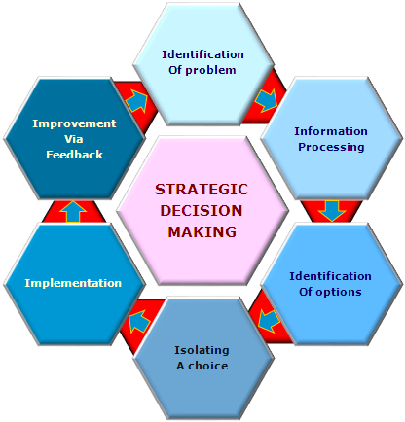
Database Design & Normalization
Effective database design is crucial for performance and integrity. Normalization reduces redundancy and improves integrity (1NF, 2NF, 3NF, etc.).

Slide 7
SQL: The Standard Language
SQL (Structured Query Language) is used for creating, querying, updating, and managing relational databases. Essential for database interaction.

Slide 8
Data Warehousing & Business Intelligence
Data Warehousing: ETL (Extract, Transform, Load) data from various sources into a central repository for analysis.
Business Intelligence (BI): Uses this data to generate reports, dashboards, and insights for decision-making. DBMS are fundamental to both.

Slide 9
Data Collection & Preparation
Methods: Surveys, interviews, experiments, observations. Data cleaning crucial: handling missing values, outliers, inconsistencies to ensure quality and reliability. Example: Retail company cleaning sales data to handle inconsistencies and outliers.

Slide 10
Descriptive, Predictive, & Prescriptive Analytics
Descriptive: Summarizes data features (mean, median, mode, visualizations). Example: Website traffic analysis.
Predictive: Forecasts future outcomes using statistical techniques and machine learning (regression, time series forecasting). Example: Credit risk assessment.
Prescriptive: Recommends actions to optimize outcomes (optimization models, simulation). Example: Airline scheduling optimization.

Slide 11
Data Interpretation & Communication
Interpret results in context, communicate findings effectively to stakeholders using reports, visualizations, and presentations. Example: Presenting customer segmentation analysis to marketing team.

Slide 12
Ethical Considerations
Data privacy, security, bias in algorithms. Responsible data handling and avoidance of discriminatory practices are crucial. Example: GDPR compliance and mitigating algorithmic bias.

Slide 13
SDLC Stages & Methodologies
Stages: Planning, Analysis, Design, Development, Testing, Implementation, Maintenance.
Methodologies: Waterfall, Agile, Spiral, RAD, DevOps. Each has strengths and weaknesses, chosen based on project needs.

Slide 14
Example: University Student Registration System
Illustrates each SDLC stage applied to a real-world scenario, highlighting the iterative and collaborative nature of the process.

Slide 15
Information Security: CIA Triad
Confidentiality: Keeping information secret.
Integrity: Ensuring information accuracy and completeness.
Availability: Guaranteeing timely and reliable access. Protecting information assets from unauthorized access, use, disclosure, disruption, modification, or destruction.

Slide 16
Types of Threats
Internal (employees), External (hackers, malware), Accidental (human error).

Slide 17
Risk Management Framework
Risk Identification, Assessment, Response (avoidance, mitigation, transference, acceptance), Monitoring & Review.

Slide 18
Security Controls & Technologies
Physical (access controls), Logical (firewalls, antivirus), Network (VPNs), Data (encryption, DLP).

Slide 19
Incident Response Planning
Preparation, Identification, Containment, Eradication, Recovery, Lessons Learned.

Slide 20
Compliance & Governance
GDPR, HIPAA, PCI DSS. Governance structures and policies ensure compliance.

Slide 21
Business Continuity & Disaster Recovery
Plans to ensure business operations continue during and after disruptions. Data backups, disaster recovery sites, business continuity plans.

Slide 22
Data Collection & Integration
Gathering data from internal and external sources. ETL processes clean, standardize, and consolidate data. Example: Retail company integrating sales, customer, and website data.

Slide 23
Data Analysis & Interpretation
Descriptive, diagnostic, predictive, and prescriptive analytics uncover patterns and trends. Tools: data mining, statistical modeling, machine learning. Example: Financial institution using predictive analytics for loan defaults.

Slide 24
Reporting & Visualization
Dashboards, reports, and visualizations communicate insights. Different report types based on audience and purpose. Example: Marketing dashboard tracking KPIs.

Slide 25
Key Performance Indicators (KPIs)
Metrics measuring success. Examples: revenue growth, customer satisfaction. Tracking KPIs shows progress toward goals. Example: Manufacturing KPIs (production efficiency, defect rates).

Slide 26
BI Tools & Technologies
Data warehousing (Snowflake, Redshift), BI platforms (Tableau, Power BI), data visualization tools (Qlik Sense).

Slide 27
Strategic Planning & MIS
Align IT infrastructure with organizational goals. Identify KPIs, develop IT strategies, ensure IT is a strategic partner. Example: Company investing in CRM for market expansion.

Slide 28
Decision-Making Processes & MIS
MIS provides data and tools for effective decision-making. Data warehousing, BI, data mining provide insights. Decision-making models (rational, bounded rationality). Example: Retail company using sales data to identify slow-moving products.

Slide 29
Types of Decisions Supported by MIS
Operational, Tactical, Strategic. MIS provides appropriate data and tools for each level.

Slide 30
Data Analytics in Strategic Planning
Descriptive, diagnostic, predictive, and prescriptive analytics inform strategic decisions. Example: Predictive analytics for demand forecasting.

Slide 31
Ethical Considerations
Fairness, transparency, privacy. Data security, algorithmic bias, data misuse. Example: GDPR compliance when using customer data.

